Slide 1
Year 6 SATs
Information afternoon
Wednesday 29th April 2026

Slide 2
Objectives
Provide information on Year 6 SATs
Share how we prepare the children
Share ideas of how you can support your child.
Discuss secondary transition
Any opportunity to ask questions.

Slide 3
Year 6 SaTs Tests
Statutory tests for Year 6 pupils set by the Department for Education DfE.
They assess what the children have learnt in Key Stage 2 (Years 3 to 6)
Children sit them in May 2026 and the DfE sets a nationwide timetable
Some children may need additional arrangements to support them and some may not sit the test. This will be discussed and agreed with you.

Slide 4
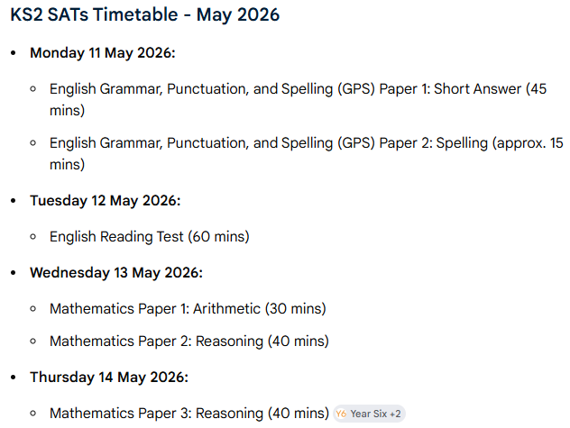
SATs timetable 2026

Slide 5
Grammar, punctuation and spelling
Only assessed through a test
2 Papers
Paper 1: Grammar, punctuation and vocabulary
45 minutes
50 marks
Most questions require multiple choice, single word or sentence answers
Importance of accuracy

Slide 6
Grammar, Punctuation and Spelling
Paper 2
Spelling Test
20 Words
All given with a context

Slide 7
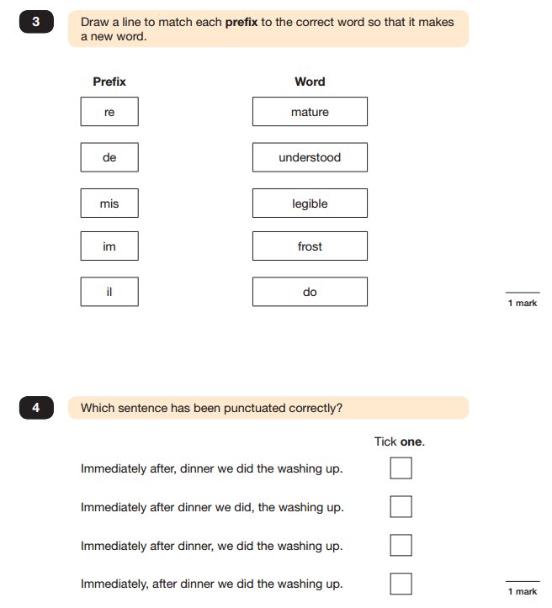

Slide 8
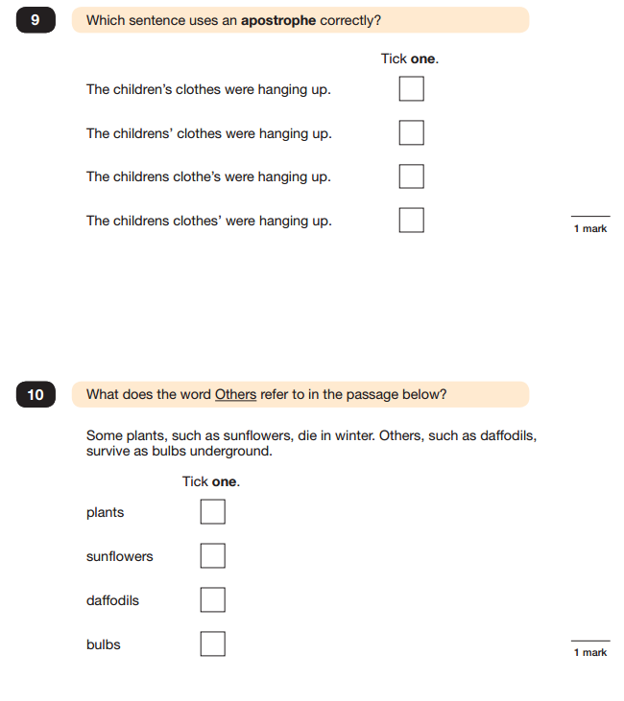

Slide 9
Reading
Teacher assessment only for those working below the standard of the tests.
For everyone else:
Reading Test
1 Hour
Reading booklet and answer booklet
50 marks available

Slide 10
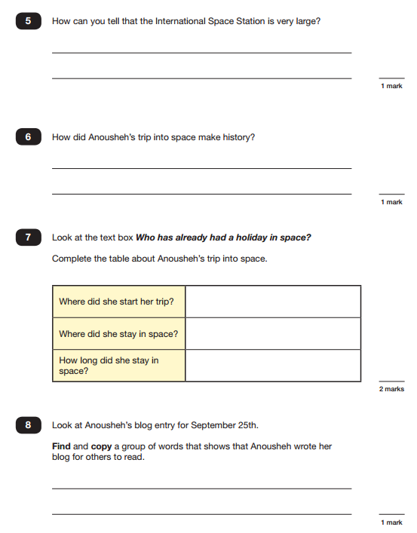

Slide 11
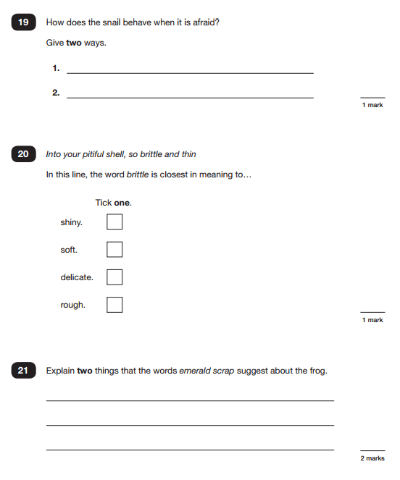

Slide 12
Mathematics
Teacher Assessment only for those below the standard of the test
For everyone else:
Maths tests: 3 papers
Paper A: Calculation 30 minutes: 40 marks.
Paper B: Reasoning 40 minutes: 35 marks
Paper C: Reasoning 40 minutes: 35 marks

Slide 13
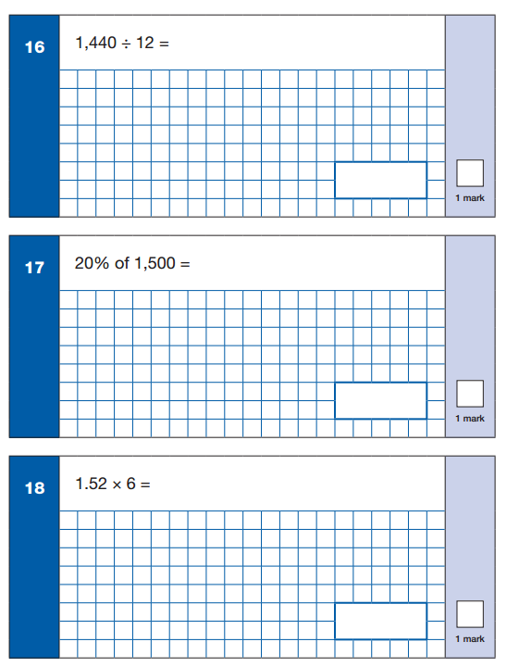

Slide 14
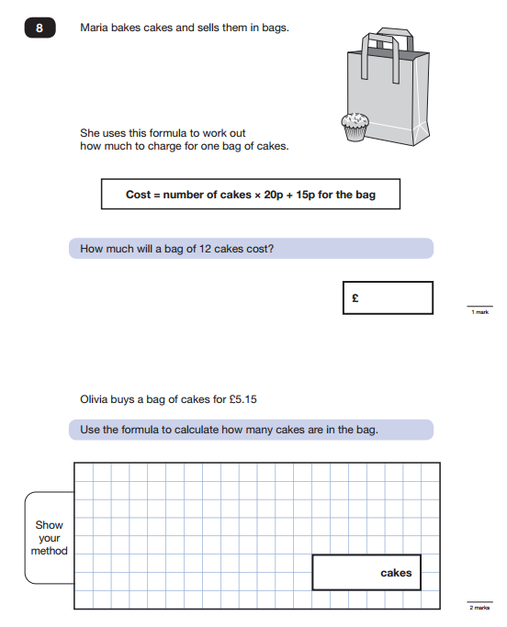

Slide 15
Writing
Assessed by teachers in June. We work together to agree our judgements and may be moderated by West Berkshire
A pupil’s writing should meet all the statements within the standard at which they are judged. However, teachers can use their discretion to ensure that, on occasion, a particular weakness does not prevent an accurate judgement being made of a pupil’s attainment overall. A teacher’s professional judgement about whether the pupil has met the standard overall takes precedence. This approach applies to English writing only.
A particular weakness could relate to a part or the whole of a statement (or statements), if there is good reason to judge that it would prevent an accurate judgement being made.

Slide 16
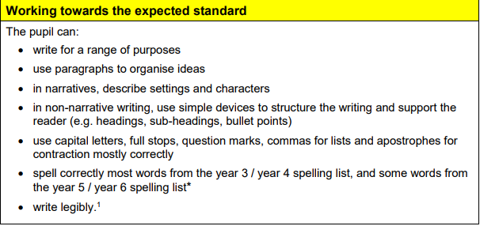

Slide 17
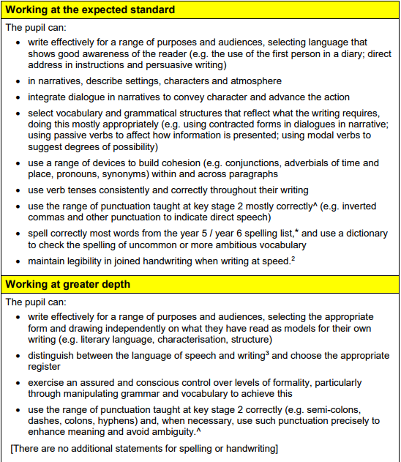

Slide 18
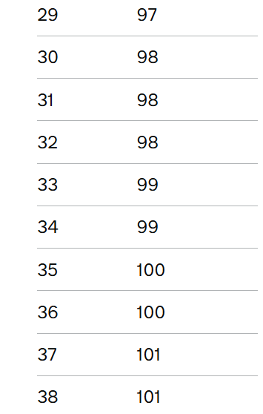
What information will be given to parents?
In the end of year report you will receive your child’s SATs results:
a raw score (the number of marks awarded)
a scaled score
and confirmation of whether or not they attained the expected standard
Teacher assessment result for writing indicating whether the expected standard has been met, or whether a child is working at greater depth, working towards etc.
Teacher assessment result for science indicating only whether the standard has been met or not.

Slide 19
Which children will sit tests?
The tests are designed to be used with all pupils who are working at the standard of the national curriculum. There will be some pupils who will be working below the ‘expected standard’ of the test, who will not achieve a scaled score of 100, but who should still take the tests. Teachers should use their knowledge of each pupil to decide whether to administer the tests to them. We will also have a conversation with parents if we feel a child is unable to access the tests.

Slide 20
Access Arrangements
Reader
Scribe
Extra time
Breaks

Slide 21
What does school do to prepare the children?
Encourage children to work hard and do their best
Teach the curriculum and provide regular feedback
Give exposure to the tests throughout Y6 including Mocks in Jan 26
Set homework
Encourage independence and personal responsibility

Slide 22
What can I do to support my child?
Encourage them to work hard and do their best.
Encourage them not to compare themselves to others.
Regular school attendance
Good sleep/good breakfast
Use the papers to identify areas they find tricky and focus on these areas.
Use the SAT buster books.
BBC Bitesize.
Regular reading
Times Tables Rockstars
Statutory spelling lists Year 3 and 4 and Year 5 and 6.

Slide 23
Transition to secondary school
This has been a 7 year journey
Getting them ready academically and socially
We will work with the secondary schools to share information.
Transition meetings and days

Slide 24
Any Questions?

