Slide 1








Slide 2
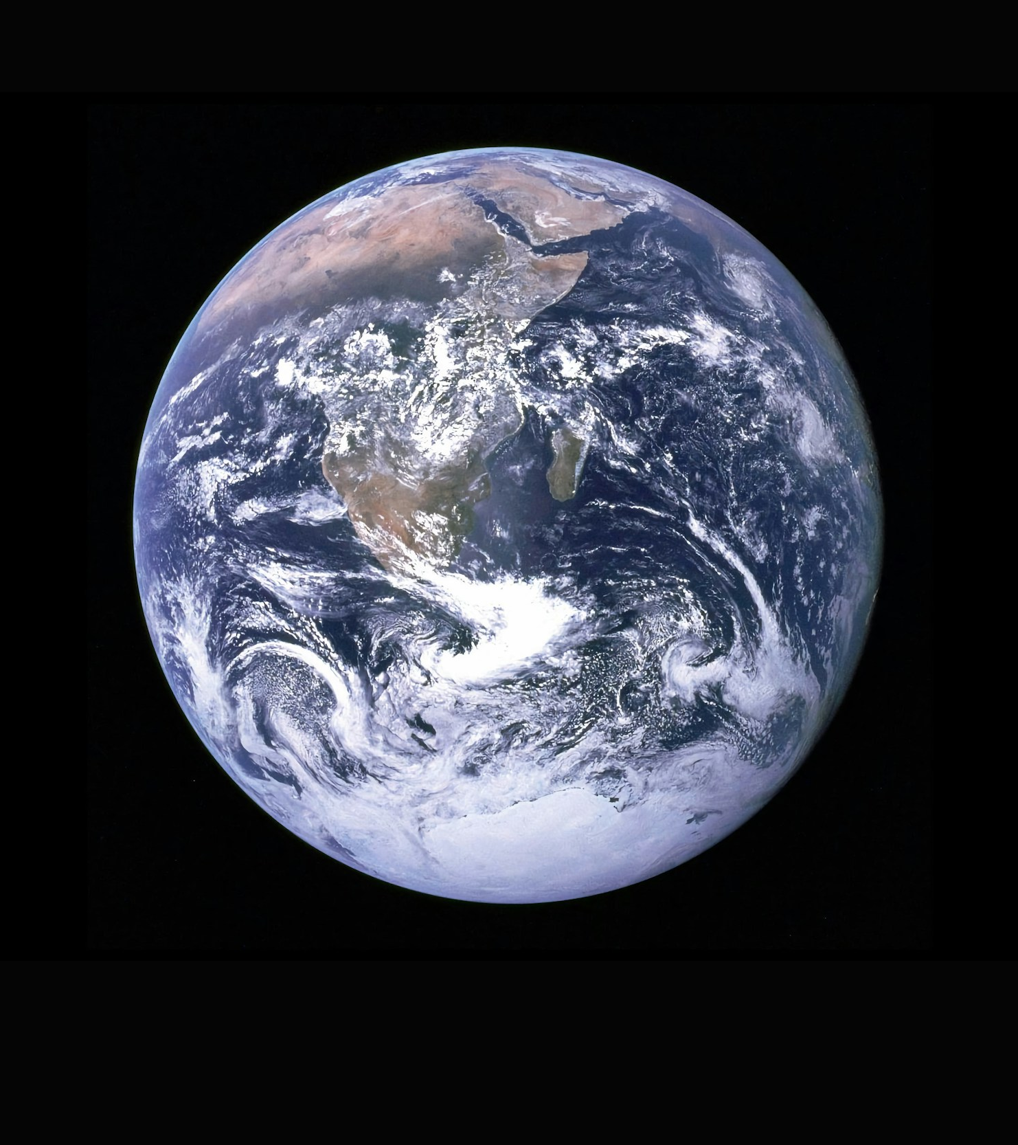


Photo by NASA
What is Carbon?
Carbon is a key part of all living things. It helps build DNA and proteins in your body, which means they can grow and work properly.
Carbon is great at connecting with other elements — and even with itself — to make different materials, from plastic to wood to steel.
In the air, carbon is present as a gas called carbon dioxide (CO₂).

Slide 3

Carbon in the air is part of a group of special gases called greenhouse gases.
They work like a blanket around Earth, keeping in just the right amount of heat. This makes the global average temperature 14°C, perfect for plants, animals and people to live.
Without greenhouse gases, our planet would be —18°C!
Photo by Nathan Dumlao on Unsplash

Slide 4

Photo by Ainur Khakimov on Unsplash
What are carbon emissions?
Many of the things that we do – from driving cars to cooking food and using electricity - are often powered by burning fuels like coal and gas.
This releases extra carbon into the air.
Too much carbon traps too much heat, and that’s causing climate change.

Slide 5

Climate change is harming our planet.
It’s melting ice caps and raising sea levels, placing coastal cities and islands at risk.
It’s creating dangerous weather events such as drought and flooding, impacting human life.
And it’s making oceans more acidic, harming plants and marine life.
Photo by shawnanggg on Unsplash

Slide 6
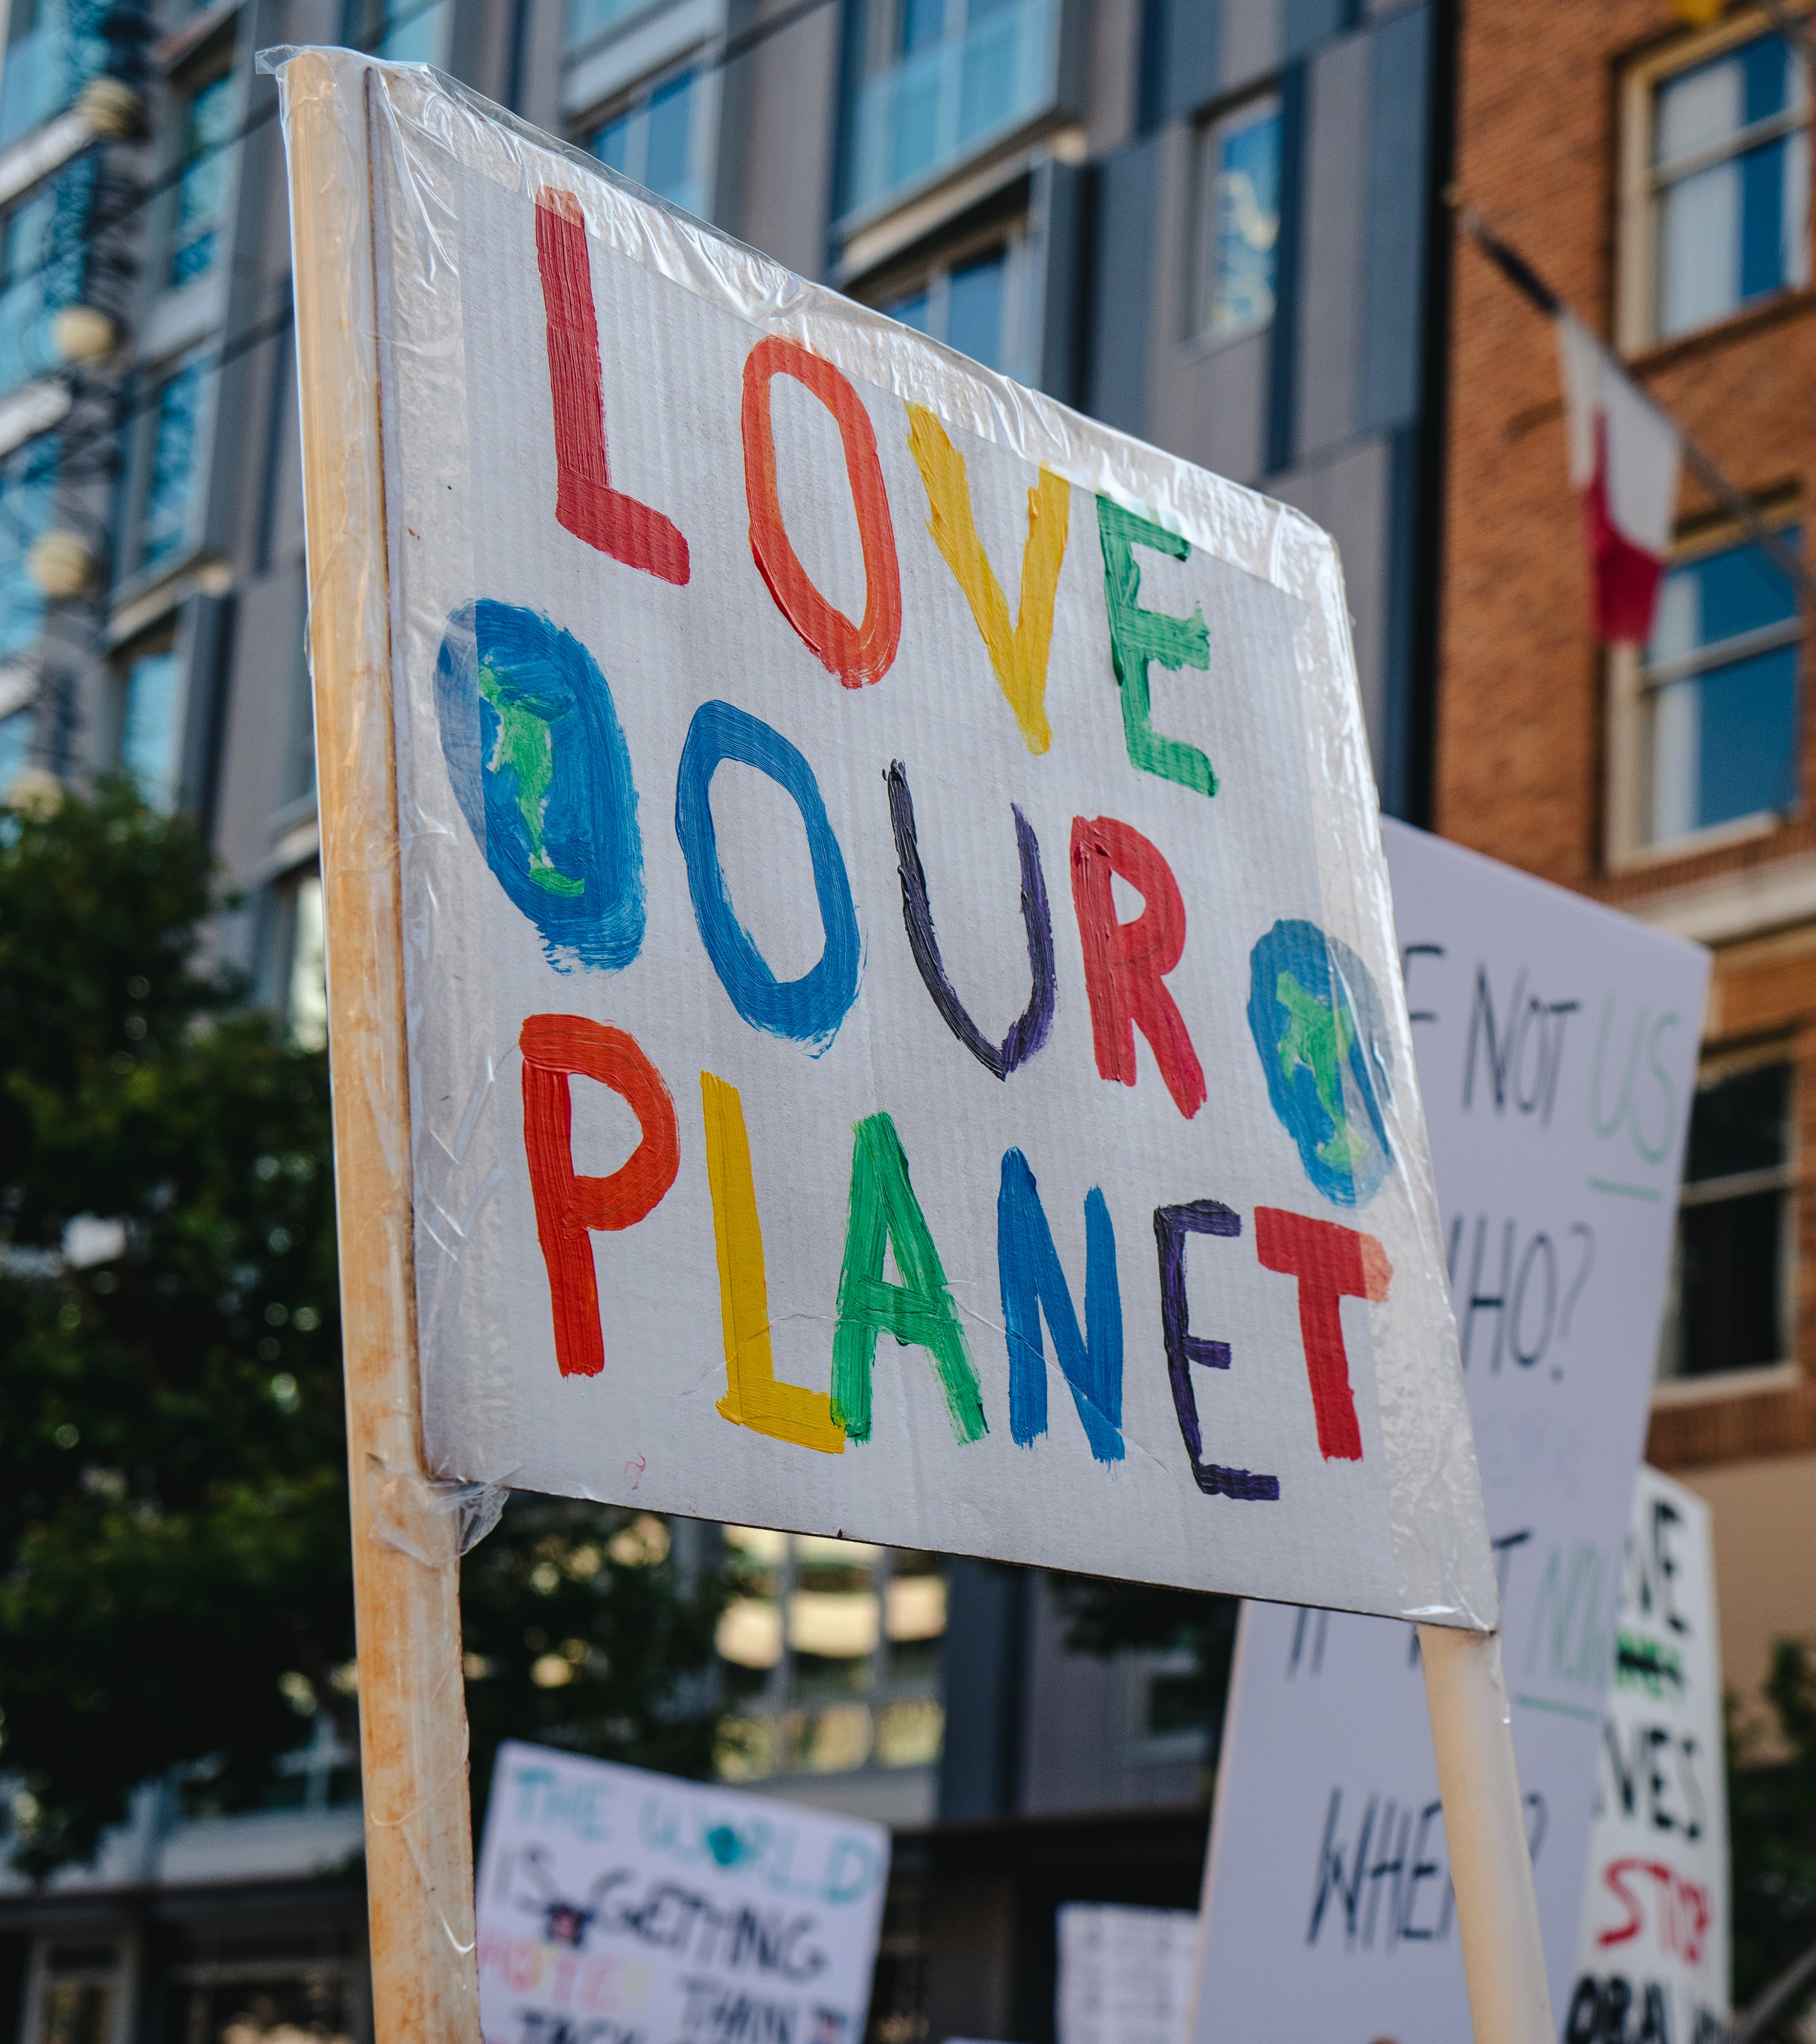
Photo by Ronan Furuta on Unsplash
Let’s Cut Your Carbon!
Whilst the big responsibility lies with governments and big businesses to make large changes, we can help too!
Through small changes, like walking instead of driving or turning off devices, we can lower carbon emissions and protect our planet.
This November, we challenge YOU to complete 6 fun activities with your family and friends to Cut Your Carbon!

Slide 7

What’s Next?
You’ll get a Cut Your Carbon checklist to take home. Complete the six challenges at home with friends and family across November.
At the end of the month, we’ll count up how many of you joined in, add up the estimated carbon saved, and celebrate your amazing efforts!
Let’s help our planet — one small step at a time!

Slide 8
Challenge 1:
Make 3 evening meals
plant-based across the month
Meat production is responsible for around 14% of the world’s greenhouse gas emissions, so make 3 evening meals plant-based across the month and discover how delicious cutting carbon can be!

Slide 9

Challenge 2:
Make 3 journeys active across the month
Transport creates nearly a quarter of the UK’s carbon emissions.
Active travel - such as walking, scooting, wheeling, or cycling - doesn’t emit anything! So, get active and ditch the drive!

Slide 10
Challenge 3:
Meal plan to reduce food waste for one week
Research suggests that the average person wastes 95kg of food per year! At each stage of the life-cycle of wasted food, from production to rotting at landfill, carbon is produced.
Plan your meals, shop smart, and waste less — it’s good for the planet and your wallet!

Slide 11
Challenge 4:
Lower your washing machine temperature to 30°C for three washes across the month
Washing machines are energy-hungry! Drop the temperature to 30°C for three washes this month and cut carbon without sacrificing clean clothes.
Cool it to care!

Slide 12

Challenge 5:
Have a device-free day
Electricity makes up about 25% of your home’s carbon footprint.
Power down non-essential devices for one day — no gaming, no streaming — and rediscover the joy of offline fun!

Slide 13
Challenge 6:
Turn down the heating by 1° for a week
Heating is the top source of home carbon emissions in the UK.
Turn it down by just 1°C for a week, layer up, and show your love for the planet — one cosy jumper at a time!

