Slide 1
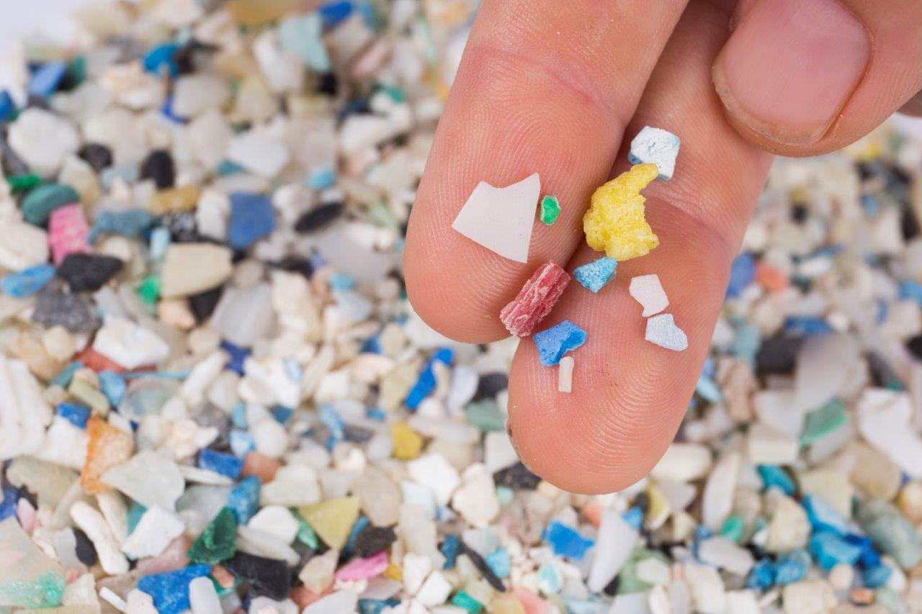
Eco-Schools Assembly Tuesday 26th March 2024
Microplastics

Slide 2
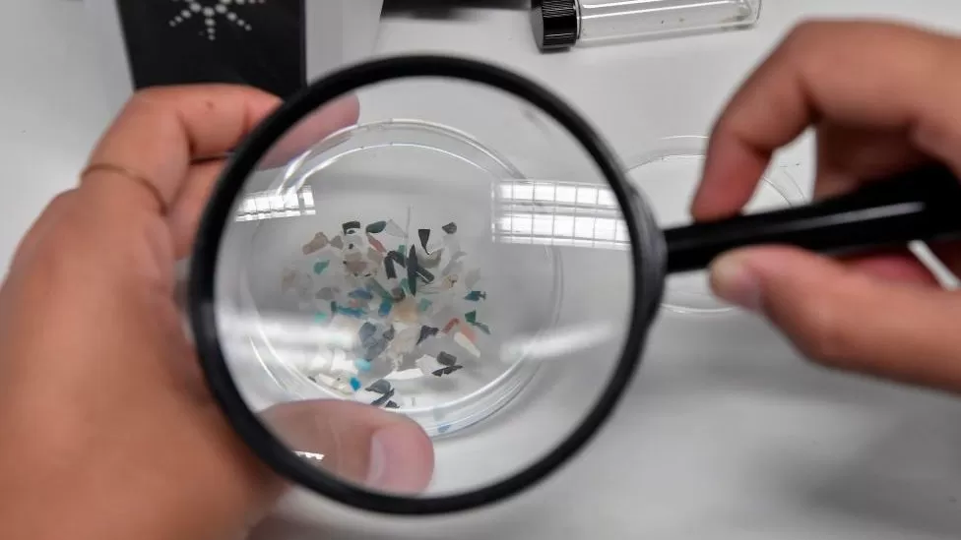
What are microplastics?
Extremely small pieces of plastic debris in the environment.

Slide 3
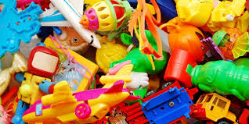
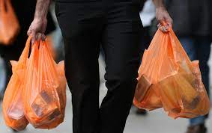
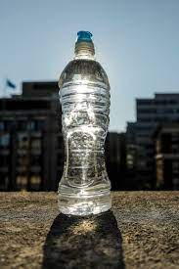
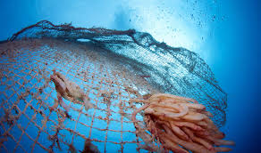
Where do microplastics come from?
They come from larger plastic items that break down into smaller pieces over time.

Slide 4
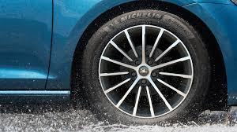
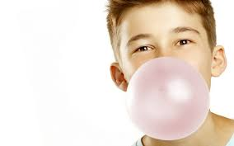
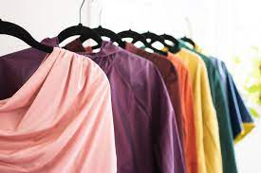
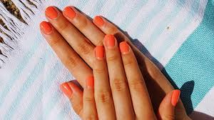
Did you know these items also contain microplastics?

Slide 5
Plastic ban
What were the three single use plastic items that the eco-committee banned last year?

Slide 6
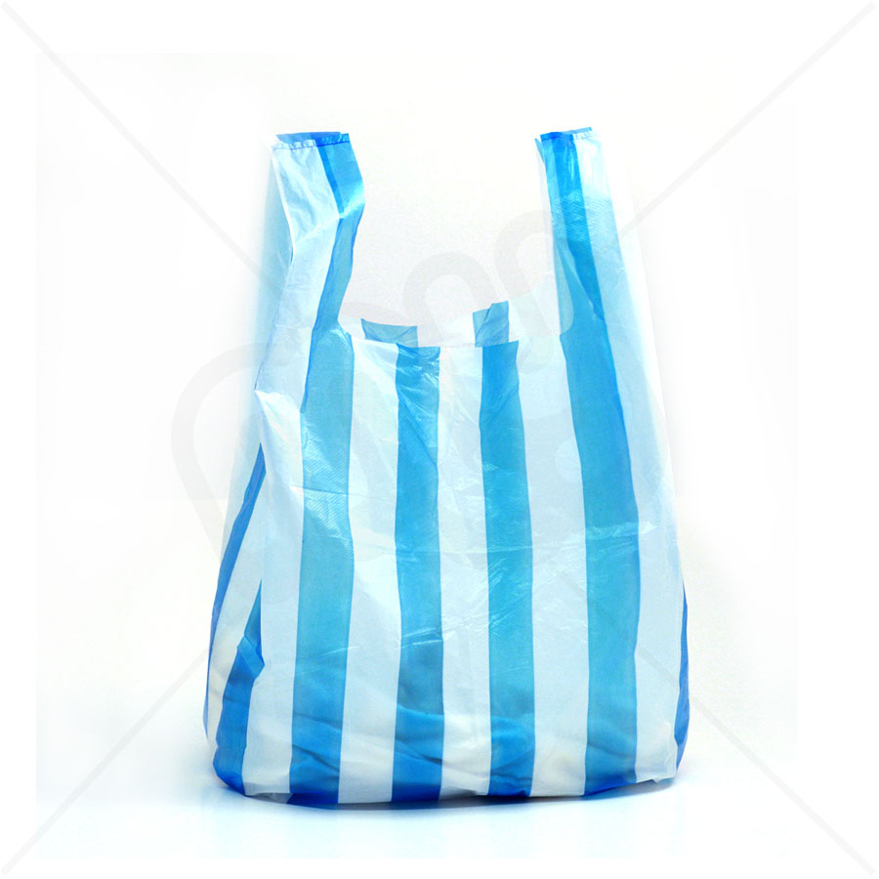
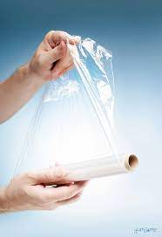
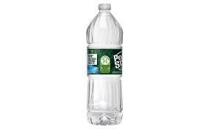

Slide 7
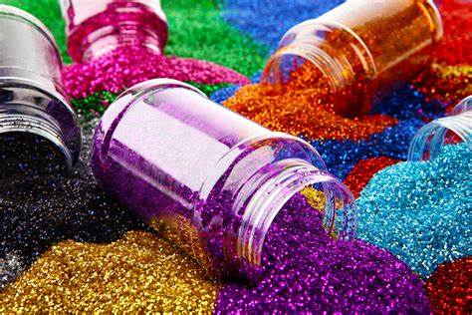
Glitter
Glitter has been an important and fun part of school life for many years. However, what many people don’t realise is that whilst glitter looks great, it’s actually a microplastic that can cause damage to our wildlife and environment.

Slide 8
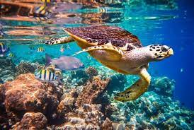
Glitter and other microplastics are particularly hazardous to our ocean life. We use glitter and other microplastics as we think they look nice. Unfortunately, when microplastics eventually end up in our oceans, marine animals also find them rather appealing. Their size makes them an attractive (but very dangerous) food item.

Slide 9
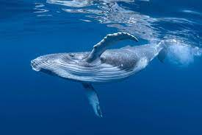
Marine animals as tiny as plankton and as big as whales have been found to eat plastics, often with fatal consequences. Research has also reported that plastic has been found in a third of UK–caught fish.

Slide 10
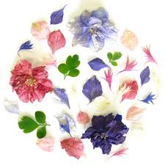
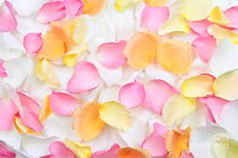
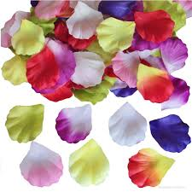
Eco-Friendly, yet equally fun, alternatives to glitter!
Any fallen leaves you find can be turned into free glitter simply by using a hole-punch.
You could also use a hole-punch to turn other items into glitter, such as reused colourful wrapping paper or cards from birthdays and Christmas.
Create a glitter garden at school, plant the most vibrant flowers you can and regularly (and carefully) pick a few petals off when required, cut into tiny pieces and you will have natural glitter!
Lentils are small, cheap and available in brown, yellow, green, red and black varieties: great for arts and crafts!
You can make salt glitter and sugar glitter. Miss Shepherd and Miss Hargood have the recipes if you want to give it a try ☺
Visit the baking isle of your local shop to find many alternatives to glitter that are usually used to decorate cakes.

Slide 11
Glitter ban
This year the eco-committee have chosen to ban glitter in school. We hope that you will help us with our campaign!

Slide 12
What could you be doing to help outside of school?
https://www.bbc.co.uk/bitesize/articles/z4d62v4#z9tb3j6

