Slide 1
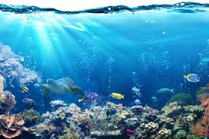
Ocean Protectors Day
Tuesday 12th March 2024

Slide 2
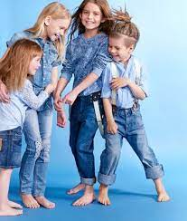
Why are we all dressed in blue today?

Slide 3
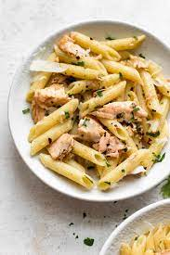
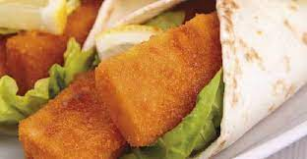
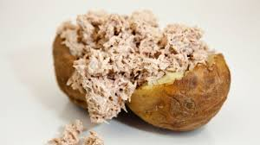
Have you ordered a school dinner today?
What did you notice about the options?

Slide 4
What is the Marine Conservation Society?
https://www.youtube.com/watch?app=desktop&v=e1V99Xg3Vxo
Up to 1:06

Slide 5
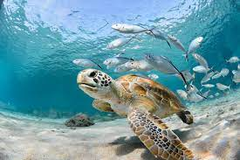
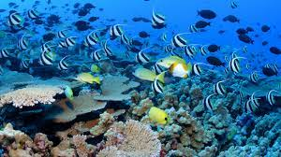
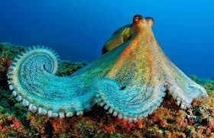
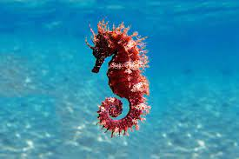
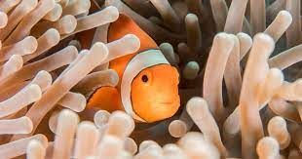
What could we be doing to protect the oceans and marine life?

Slide 6
Today you are going to be doing activities in class that will teach you about the impact of single use plastic on marine life.

